Slide 1




MBC 638: Data Analysis & Decision Making
Anna Chernobai
Lecture 02:
Graphical & numerical descriptive measures for sample data (Chapters 2, 3)

Slide 2
Today:
Population vs. sample
Data and variable types
Graphical descriptive measures
For categorical data
For numerical data
Numerical descriptive measures
For categorical data
For numerical data

Slide 3
1. Population vs. sample
Population is the set representing all measurements of interest.
Examples:
all voters in presidential elections
all US companies
all MBA students in the United States in 2017
Sample is a subset of the population.
Examples:
2,000 voters in a recent survey
Selected US companies that are rated by Moody’s
this MBA class

Slide 4
1. Population vs. sample
Population is the set representing all measurements of interest.
Examples:
all voters in presidential elections
all US companies
all MBA students in the United States in 2017
Sample is a subset of the population.
Examples:
2,000 voters in a recent survey
Selected US companies that are rated by Moody’s
this MBA class
Usually, a population is very large. Examining the entire population is often impractical or impossible. Therefore, in order to make any generalizations about a population, a sample is often studied.
The sample should be a random sample. Then, the sample is representative of the population as a whole.

Slide 5
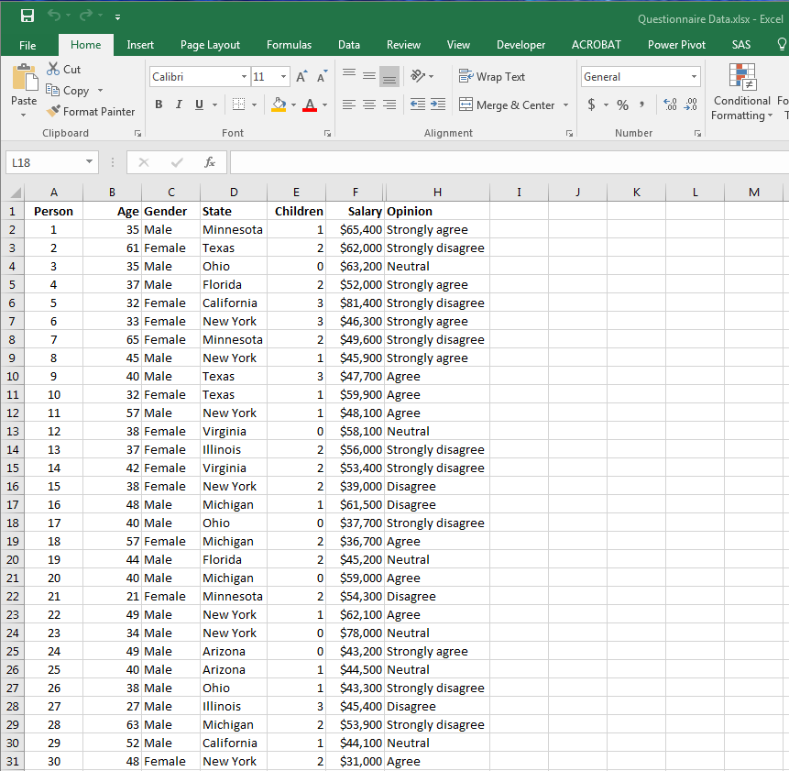
1. Population vs. sample
Is this a sample or a population?

Slide 6

Today:
Population vs. sample
Data and variable types
Graphical descriptive measures
For categorical data
For numerical data
Numerical descriptive measures
For categorical data
For numerical data

Slide 7
2. Random variables, data, observations
A variable is a characteristic of members of a population.
A data set is an array of data (M×N).
An observation is a list of all variable values for a single member of a population.

Slide 8
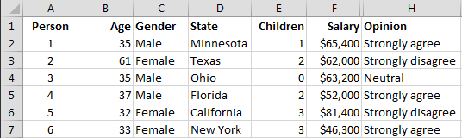
2. Random variables, data, observations
A variable is a characteristic of members of a population.
A data set is an array of data (M×N).
An observation is a list of all variable values for a single member of a population.
Data set:

Slide 9
2. Random variables, data, observations
A variable is a characteristic of members of a population.
A data set is an array of data (M×N).
An observation is a list of all variable values for a single member of a population.
Data set:
variables (columns)

Slide 10
2. Random variables, data, observations
A variable is a characteristic of members of a population.
A data set is an array of data (M×N).
An observation is a list of all variable values for a single member of a population.
Data set:
Observations
(rows)

Slide 11
2. Random variables, data, observations
A variable is a characteristic of members of a population.
A data set is an array of data (M×N).
An observation is a list of all variable values for a single member of a population.
Data set:
variable name
Observation
index

Slide 12
2. Data types (variable types)
Qualitative
(categorical)
Nominal
Ordinal
Quantitative (numerical)
Discrete
Continuous

Slide 13
2. Data types (variable types)
Qualitative
(categorical)
Nominal
Ordinal
Represents a certain group or category or quality
A natural ordering is not possible.
E.g. eye color, college major, company name, gender, ethnicity.
A natural ordering of possible values can be assigned.
E.g. place that a runner finishes in a marathon; grade (A, B, C); opinion (disagree, neutral, agree).

Slide 14
2. Data types (variable types)
Can be measured in numerical values for which arithmetic operations (adding, subtracting, averaging) make sense
e.g. GPA, height, weight, $, %, # of people, temperature
Quantitative (numerical)
Discrete
Continuous
Typically, take whole digit values.
e.g. Number of companies, number of people, age (in whole years).
Can take any value.
e.g. temperature, height, salary, home price.
Note: Quantitative variables are measured in units of measurement, such as $, feet, pounds, %, …

Slide 15
2. Data types (variable types)
Categorical
Ordinal
Numerical
Discrete
Categorical
Nominal
Numerical
Continuous

Slide 16
2. Data types (variable types)
Quantitative (or numerical) variables/data can also be:
Cross-sectional: a cross section of a population at a point in time.
Time series (longitudinal): data on the same entity are collected over time.
Cross-sectional time series: panel data.

Slide 17
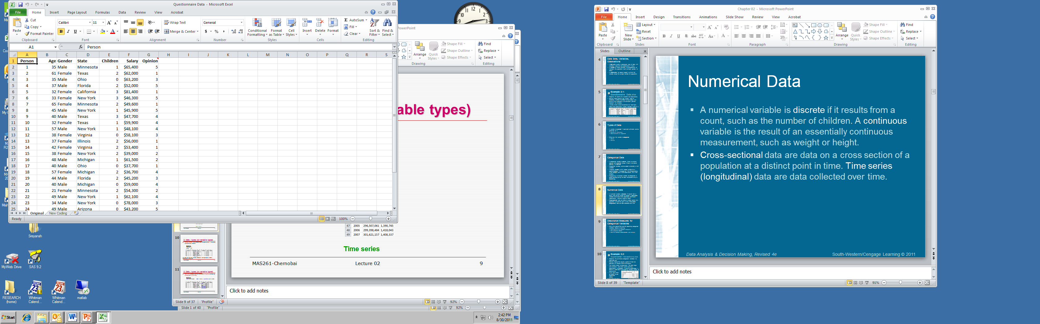
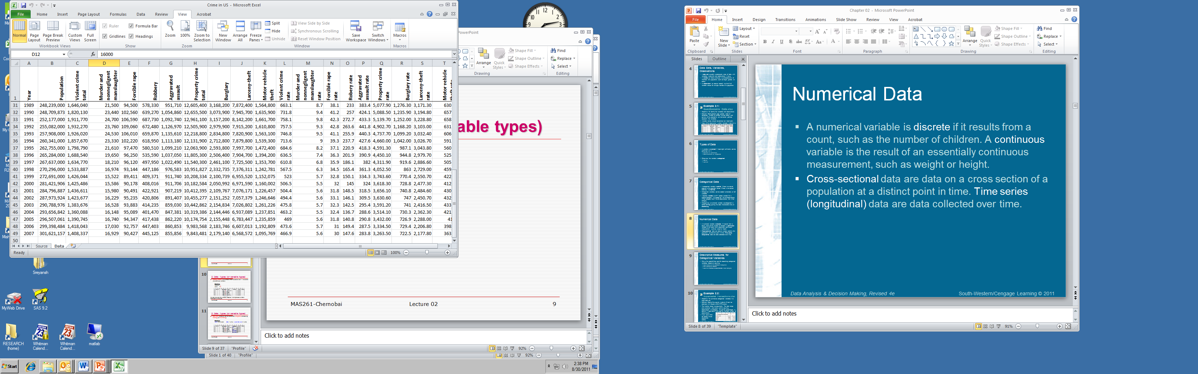
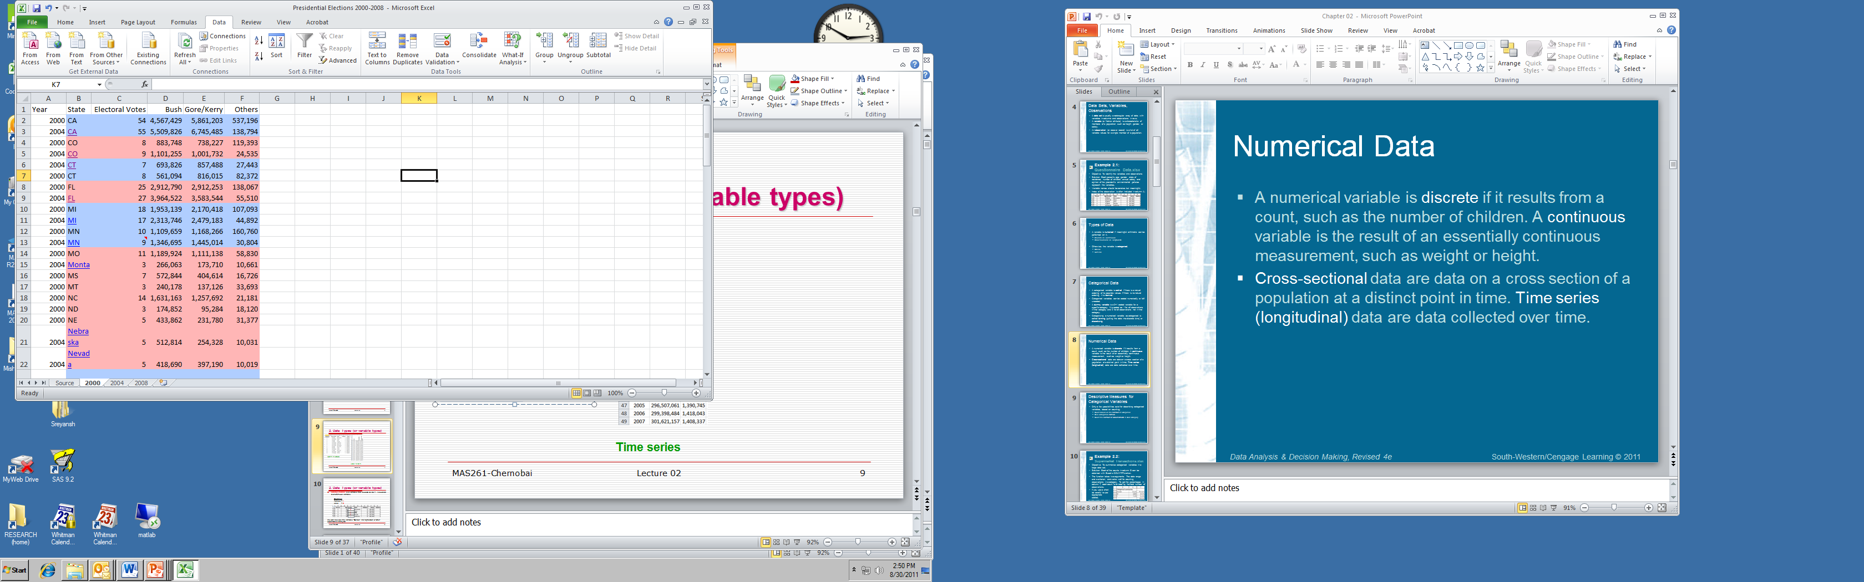
2. Data types (variable types)
Example 1: Example 2: Example 3:
A survey
Cross-sectional
Presidential elections 2000, 2004
Cross-sectional time series
U.S. crime data 1989-2007
Time series

Slide 18
2. Data types (variable types)
Dummy variable is an example of a categorical (dichotomous) variable that is coded as 0 or 1.
Example: 1 = Female 0 = Male
0
1
0
0
1
1

Slide 19
2. Data types (variable types)
Numerical variables can be turned into categorical variables by binning (or discretizing).
Example: None = 0 children One = 1 child More than one = >1 child
One
More than one
None
More than one
More than one
More than one

Slide 20
2. Data types (variable types)
Categorical variables can be turned into numerical variables, but only for ordinal categorical variables.
Example: 1 = strongly disagree, 2 = disagree, 3 = neutral, 4 = agree, 5 = strongly agree
5
1
3
5
1
5

Slide 21
Today:
Population vs. sample
Data and variable types
Graphical descriptive measures
For categorical data
For numerical data
Numerical descriptive measures
For categorical data
For numerical data

Slide 22
3. Graphical descriptive measures: categorical data
Qualitative
(categorical)
Nominal
Ordinal
Quantitative (numerical)
Discrete
Continuous

Slide 23
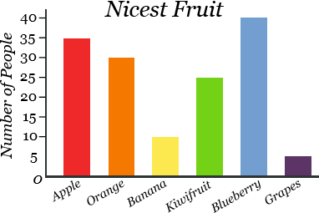
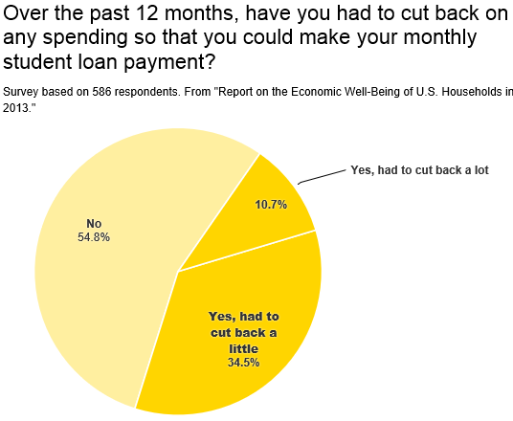
3. Graphical descriptive measures: categorical data
Bar graph
Pie chart

Slide 24
3. Graphical descriptive measures: categorical data
Bar graph compares the sizes of the categories.
Pie chart helps us see the proportion of each category out of total.

Slide 25

Today:
Population vs. sample
Data and variable types
Graphical descriptive measures
For categorical data
For numerical data
Numerical descriptive measures
For categorical data
For numerical data

Slide 26
3. Graphical descriptive measures: quantitative data
Qualitative
(categorical)
Nominal
Ordinal
Quantitative (numerical)
Discrete
Continuous

Slide 27
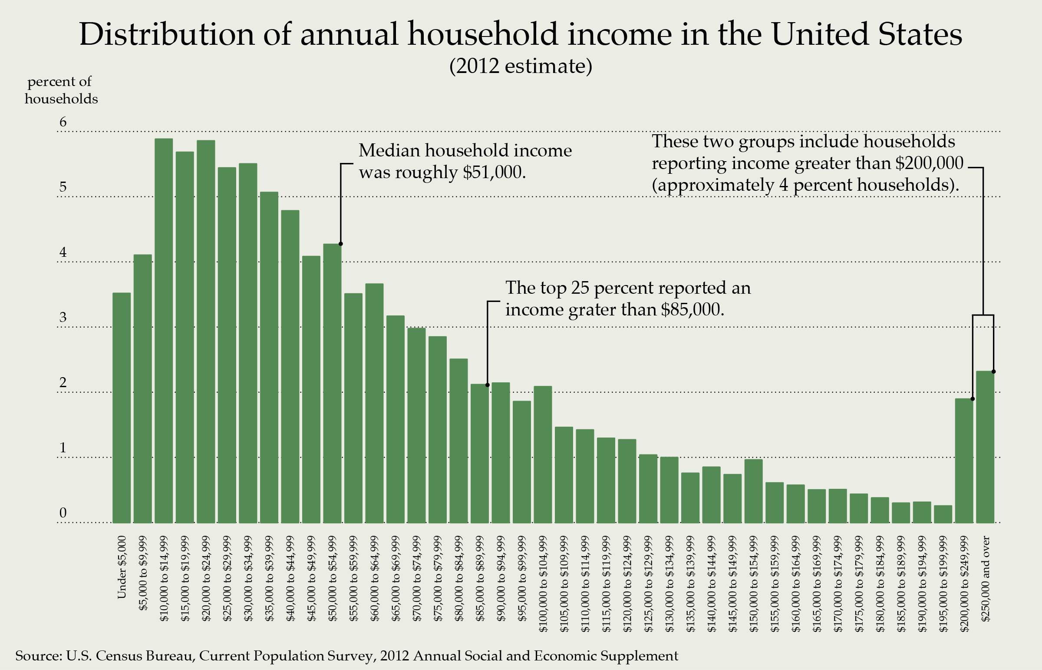
3. Graphical descriptive measures: quantitative data
Histogram shows the distribution of quantitative data.
Data are split into equal-length bins and the number of observations in each bin is calculated.
X-axis: Data values (bins)
Y-axis: #obs. in each bin
Relative frequency
histogram
Y-axis: Proportion of
data in each bin

Slide 28
3. Graphical descriptive measures: quantitative data
What to look for when describing quantitative data graphically:
What are the most typical data?
Where is the center of the data?
Is the distribution symmetric? If not, is it right-skewed? Left-skewed?
How spread out are the values?
What are the extreme values? Are there outliers?
Are there any other interesting features of the data?

Slide 29
3. Graphical descriptive measures: quantitative data
Describing data shape:
Symmetric vs. asymmetric (Skewed)
Number of peaks (#Modes)
Unusual observations (Outliers)

Slide 30
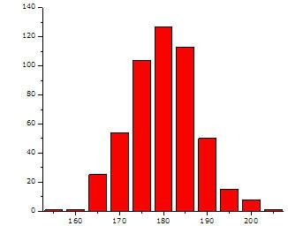
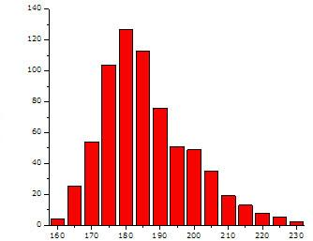
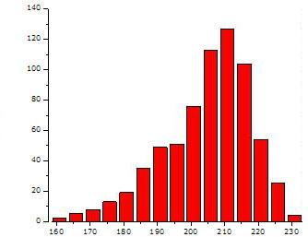
3. Graphical descriptive measures: quantitative data
Symmetric vs. skewed
Symmetric data:
Stock returns over a long period of time
Right-skewed data:
Financial losses
Insurance claims
Housing prices
Salaries
long right tail
long left tail
Left-skewed data:
GPA
The number of days before a homework is due (e.g., -5, -4, …) when you begin working on it (it’s due at t=0).

Slide 31
3. Graphical descriptive measures: quantitative data
Peakedness = number of modes or peaks
Unimodal Bimodal
Note: (1) data can have more than 1-2 peaks (multimodal).
(2) data may have no modes (e.g. uniform distribution)

Slide 32
3. Graphical descriptive measures: quantitative data
Outliers
= an unusual observation (typically unusually small or large) compared to the rest of the data.
There can be different reasons for outliers:
It may be simply a recording error. Many errors in stock trading are key stroke errors!
Or, it indicates unusual observations that may deserve further attention.
Later in this class we will learn 2 methods of detecting outliers formally.

Slide 33
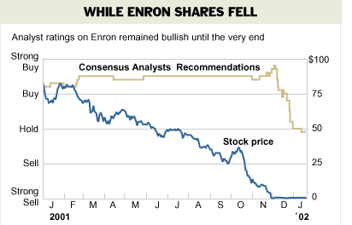
3. Graphical descriptive measures: quantitative data
Previous examples were based on random sample data (only 1 dimension: value).
Sometimes we are interested in how data behave over time. For time series data (2 dimensions: variable value and time), we construct a time-series plot.

Slide 34
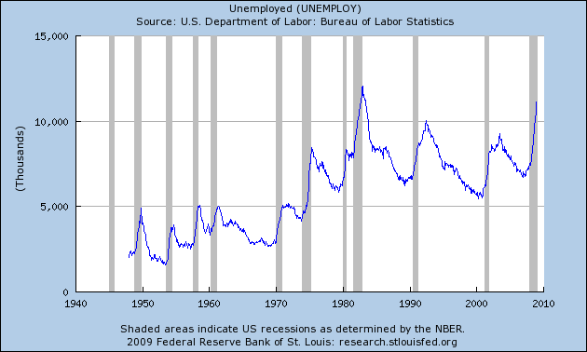
3. Graphical descriptive measures: quantitative data
The number of unemployed in the U.S. 1940-2009:
Economic
recessions

Slide 35
Today:
Population vs. sample
Data and variable types
Graphical descriptive measures
For categorical data
For numerical data
Numerical descriptive measures:
For categorical data
For numerical data

Slide 36
4. Numerical descriptive measures: categorical data
Qualitative
(categorical)
Nominal
Ordinal
Quantitative (numerical)
Discrete
Continuous

Slide 37
4. Numerical descriptive measures: categorical data
There is not much you can do with one categorical variable! Count the number (or proportion) of observations in each category.
There is more you can do with 2 categorical variables:
To examine the relationship between two categorical variables, you can use cross-tabulation (or crosstabs or contingency table or pivot table):
 | Non-smoker | Occasional smoker | Heavy smoker | TOTAL:
Non-drinker | 2118 | 435 | 163 | 2716
Occasional drinker | 2061 | 1067 | 552 | 3680
Heavy drinker | 733 | 899 | 733 | 2365
TOTAL: | 4912 | 2401 | 1448 | 8761

Slide 38
4. Numerical descriptive measures: categorical data
There is not much you can do with one categorical variable! Count the number (or proportion) of observations in each category.
There is more you can do with 2 categorical variables:
To examine the relationship between two categorical variables, you can use cross-tabulation (or crosstabs or contingency table or pivot table):
 | Non-smoker | Occasional smoker | Heavy smoker | TOTAL:
Non-drinker | 2118 | 435 | 163 | 2716
Occasional drinker | 2061 | 1067 | 552 | 3680
Heavy drinker | 733 | 899 | 733 | 2365
TOTAL: | 4912 | 2401 | 1448 | 8761
Joint counts

Slide 39

Today:
Population vs. sample
Data and variable types
Graphical descriptive measures
For categorical data
For numerical data
Numerical descriptive measures
For categorical data
For numerical data

Slide 40
4. Numerical descriptive measures: quantitative data
Qualitative
(categorical)
Nominal
Ordinal
Quantitative (numerical)
Discrete
Continuous

Slide 41
4. Numerical descriptive measures: quantitative data
Describing the distribution of quantitative data numerically:
1. Measures of location:
minimum, maximum, percentiles, quartiles
2. Measures of central tendency:
mean, median, mode
3. Measures of spread (or measures of variability):
range, variance, standard deviation, MAD, IQR
4. Measures of shape
skewness (we’ve already talked about it), kurtosis

Slide 42
4. Numerical descriptive measures: quantitative data
What to look for when describing the distribution of quantitative data numerically? Generally, the same principle as when describing data graphically:
What are the most typical data?
Where is the center of the data?
Is the distribution symmetric? If not, is it right-skewed? Left-skewed?
How spread out are the values?
What are the extreme values? Are there outliers?
Are there any other interesting features of the data?

Slide 43
4. Numerical descriptive measures: quantitative data
1. Measures of location:
Percentile: A pth percentile is a value such that at least p% of the observations are less than or equal to this value.
25%
25%
25%
25%
25th percentile 50th percentile 75th percentile
=first quartile =second quartile =third quartile
=Q1 =Q2 =Q3
min
max
99th percentile

Slide 44
4. Numerical descriptive measures: quantitative data
2. Measures of central tendency:
A. Sample Mean
B. Sample Median
C. Sample Mode

Slide 45
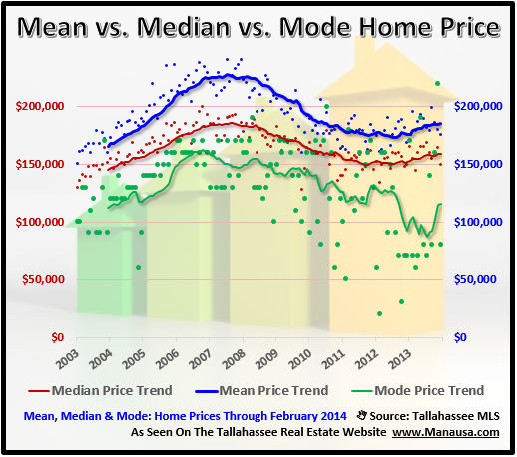
4. Numerical descriptive measures: quantitative data

Slide 46
4. Numerical descriptive measures: quantitative data
A. Sample mean = average value
Sample: 1 3 7 2 9 4
x₁ x₂ x₃ x₄ x₅ x₆ n=6 =sample size =#data points
= ( x₁ + x₂ + x₃ + x₄ + x₅ + x₆ ) / 6 = 26/6 = 4.333
Example

Slide 47
4. Numerical descriptive measures: quantitative data
is sensitive to outliers.
Example
Data set 1: 1 3 7 2 9 4 →
Data set 2: 1 3 7 2 9 4 15 →
Outliers can ‘drive’ the sample mean in an unwanted direction.
Therefore, mean is not a good measure of center for skewed data or data with outliers.

Slide 48
4. Numerical descriptive measures: quantitative data
Other variations of sample mean:
Trimmed mean:
Top x% and bottom x% of data are truncated.
Mean of winsorized data:
Data >x^{th} percentile is set equal to x^{th} percentile;
data <y^{th} percentile is set equal to y^{th} percentile.
Weighted mean:
Data is organized in compact form: sample value & frequency.

Slide 49
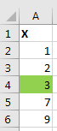
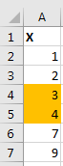
4. Numerical descriptive measures: quantitative data
B. Sample median = middle value of sorted data
Step 1: sort the data in increasing order
Step 2:
a) if n is odd:
Median = the middle value of sorted data
( th ordered observation)
b) if n is even:
Median = the average of the 2 middle values of sorted data
( the average of the th and th ordered observations)

Slide 50
4. Numerical descriptive measures: quantitative data
Median cuts data in half. Therefore, median is the 50th percentile of data.
f
50%
50%
x
Median

Slide 51
4. Numerical descriptive measures: quantitative data
Median is NOT sensitive to outliers.
Data set 1: 1 3 7 2 3 → median = 3
Data set 2: 1 3 7 2 15 → median = 3
Example
Therefore, median is a good measure of center even for skewed data or data with outliers.

Slide 52
4. Numerical descriptive measures: quantitative data
Symmetric data
Left-skewed data
Right-skewed data
Mean ≈ Median
Mean=median
Mean < Median
Mean<median
Mean > Median
Median<mean

Slide 53
4. Numerical descriptive measures: quantitative data
Median housing prices:
CNNMoney.com January 6, 2009: “NYC real estate defies gravity – so far”
CNNMoney.com August 16, 2007: “Latest home prices”
CNNMoney.com 2012: “Most affordable U.S. cities to buy a home” 8.Syracuse, N.Y.
Median income:
Huffington Post, August 22, 2013: “Median household income dropped 4 percent since the end of the great recession: report”
(Right-click on the underlined link → Open Hyperlink)

Slide 54
4. Numerical descriptive measures: quantitative data
C. Sample mode = the most frequent observation.
Usually used for discrete quantitative data.
Mode = 3
Mode = 7
Data sample: 4 3 6 3 7 6 1 3 Mode = 3
Example

Slide 55
4. Numerical descriptive measures: quantitative data
3. Measures of spread
Range
IQR
Sample Variance (s²)
Sample Standard Deviation (s)
MAD

Slide 56
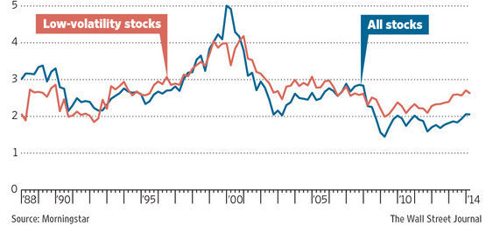
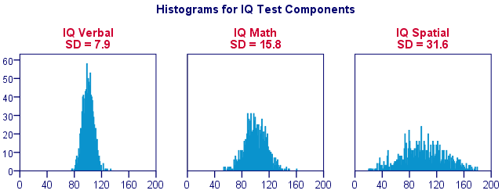
4. Numerical descriptive measures: quantitative data
3. Measures of spread
Range
IQR
Sample Variance (s²)
Sample Standard Deviation (s)
MAD

Slide 57
4. Numerical descriptive measures: quantitative data
A. Range = Max - Min
However, this measure of spread is too limited, because it only takes 2 values into consideration, and so it doesn’t tell us much about the data…
Dotplot:
Same range (11-1=10) but Data C4 is more spread out than C5.
Range is sensitive to outliers.

Slide 58
4. Numerical descriptive measures: quantitative data
B. IQR = InterQuartile Range
f
IQR shows the range of the data around the center (middle 50%) of the distribution.
25%
25%
25%
25%
x
Q1 Q2 Q3
=median
IQR = Q3 –Q1
IQR is not sensitive to outliers.

Slide 59
4. Numerical descriptive measures: quantitative data
C. Sample variance captures the average spread of data around the mean.
Example
Data: 1 5 3 4 7 n=5
[(1-4)² + (5-4)² + (3-4)² + (4-4)² + (7-4)² ]/(5-1)=5
x₁ x₂ x₃ x₄ x₅
S²=

Slide 60

4. Numerical descriptive measures: quantitative data
Apple
6-month history of stock returns
Coca-Cola
High variance = high risk

Slide 61
4. Numerical descriptive measures: quantitative data
D. Sample standard deviation = square root of variance
Why use standard deviation, not variance?
Variance is measured in (units of measurement)². Standard deviation is measured in the original units of measurement.
There are many more applications of standard deviation than variance. We will learn them in this course.

Slide 62
4. Numerical descriptive measures: quantitative data
E. Mean absolute deviation (MAD)
It is a more robust (less sensitive to outliers) measure of spread than variance or standard deviation.
For many variables, st. deviation is approximately 25% larger than MAD: s ≈ 1.5 MAD

Slide 63
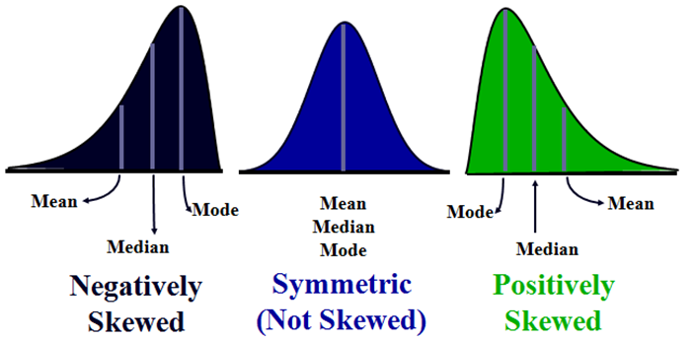
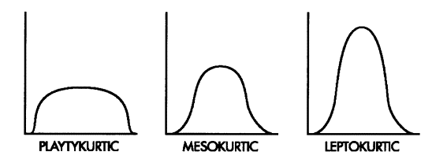
4. Numerical descriptive measures: quantitative data
4. Data shape:
■ Skewness occurs because of a lack of symmetry.
Skewness > 0 means right-skewness.
Skewness < 0 means left-skewness.
For the normal distribution, skewness = 0.
■ Kurtosis shows the “peakedness” of the distribution, compared to the normal distribution. Usually, high peak comes with “fat tails.” I.e., kurtotic data has many extreme observations.
For the normal distribution (any μ, any σ), kurtosis = 3.

Slide 64
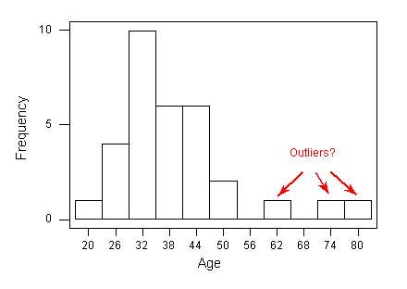
4. Numerical descriptive measures: quantitative data
More on outliers
Recall, outlier is an observation that is unusually large or unusually small.

Slide 65
4. Numerical descriptive measures: quantitative data
How do we detect outliers formally?
Key idea: Determine some high/low boundaries (thresholds) such that any observations beyond those boundaries are outliers.
Note: Depending on which method you use, the results may vary.

Slide 66
4. Numerical descriptive measures: quantitative data
How do we detect outliers formally?
Key idea: Determine some high/low boundaries (thresholds) such that any observations beyond those boundaries are outliers.
Note: Depending on which method you use, the results may vary.

Slide 67
4. Numerical descriptive measures: quantitative data
■ Method #1 of outlier detection:
Lower fence = Q1 – (1.5 × IQR)
Upper fence = Q3 + (1.5 × IQR)
Observations below the lower fence and above the upper fence are outliers.
Some textbooks differentiate between mild and extreme outliers:
Observations between 1.5 IQR and 3 IQR away from Q1 and Q3 are sometimes called mild outliers.
Observations further than 3 IQR’s away from Q1 and Q3 are often called far (or extreme) outliers.

Slide 68
Box Plot
4. Numerical descriptive measures: quantitative data
extreme outlier
max
*
*
mild outlier
Upper fence
Q3
median
Q1
Lower fence
min

Slide 69
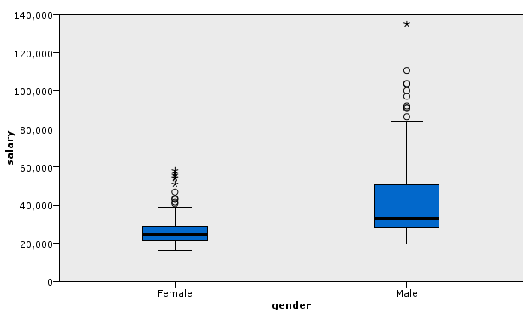
4. Numerical descriptive measures: quantitative data
Box plots are useful to compare distributions of 2 or more samples.
Example
Salary distribution
by gender.

Slide 70
4. Numerical descriptive measures: quantitative data
Sample z-score
Standardize data in the following way:
Z-score shows how many standard deviations an observation x is away from the mean.
Z-scores are very useful in statistics and business applications. We will see many examples in this class.

Slide 71
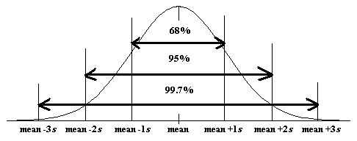
4. Numerical descriptive measures: quantitative data
■ Method #2 of outlier detection:
If a sample value x is not an unusual observation, then:
If the absolute value of the z-score is >2 but ≤3, then x is a possible outlier.
If the absolute value of the z-score is >3, then x is a definite outlier.
Empirical Rules: When data sample is approximately “bell-shaped”, then
Approximately 68% of all data lie within 1 standard deviation away from the mean.
Approximately 95% of all data lie within 2 standard deviations away from the mean.
Approximately 99.7% of all data lie within 3 standard deviations away from the mean.

Slide 72
Today:
Population vs. sample
Data and variable types
Graphical descriptive measures
For categorical data
For numerical data
Numerical descriptive measures
For categorical data
For numerical data

